Slide 1
The Perfect Self Funded Plan – Your Options, Strategies, and Future Opportunities
Presented by:
Adam V. Russo, Esq.
CEO, The Phia Group, LLC
October 8, 2015

Slide 2
Overview
Introduction to The Phia Group
Costs: What Do You Care About?
Growth of Self-Funding
Risk Management
Self-funding: Synonymous with Innovation

Slide 3
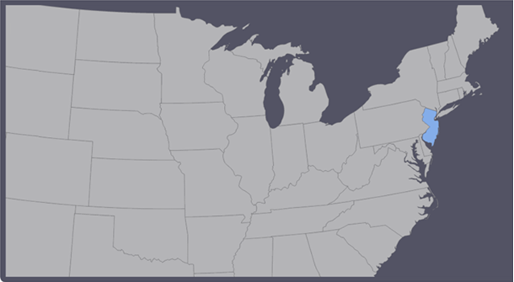
The Phia Group IN 2000

Slide 4
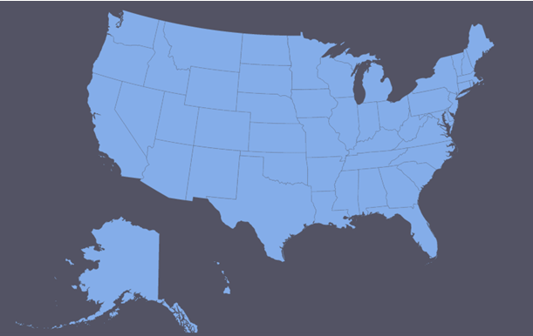
The Phia Group IN 2015

Slide 5
The Phia Group IN 2015
The Phia Group, by the numbers:
18 brokers
41 stop-loss carriers and MGUs
243 TPAs
101,000 employer groups
- Including Taft-Hartley, unions, captives, consortiums, MEWAs
6,300,000 employee lives
Countless dollars saved

Slide 6
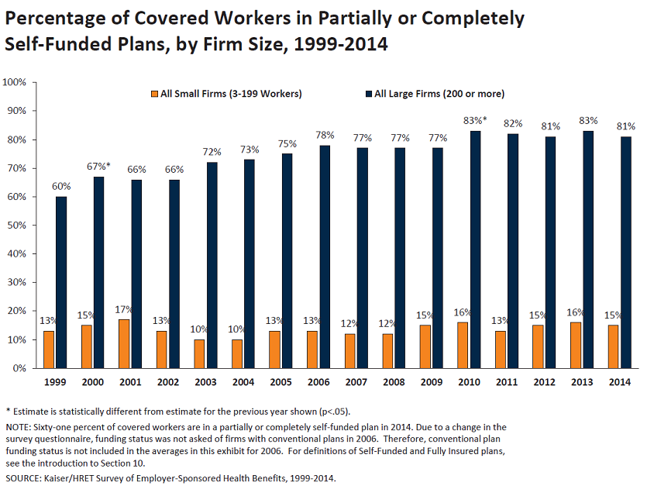
Growth of Self-funding

Slide 7
Growth of Self-funding
DOI forced to approve 6% fully-insured premium increase for 2016
Up from 2% increase in 2014 and 3% increase in 2015
Meanwhile, Mass. hospital profits are soaring
Mass General ($200MM profit in 2015)
Brigham and Women’s ($152MM profit in 2015)
“Where else do you go, except not offering health insurance,
or not offering raises, or cutting back staff?”
Jon Hurst, president of the Retailers Assn. of MA
Is self-funding the answer?
https://www.bostonglobe.com/business/2015/08/27/health-insurance-rates-rise-percent-for-small-employers/

Slide 8
Growth of Self-funding
Massachusetts as Bellwether
Overall, 73.8 percent of workers in Massachusetts were in self-insured plans in 2011, the highest rate in the nation.
Since 2006, when Massachusetts passed its health care reform law, the percentage of workers statewide in self-insured plans has increased as follows:
• In firms with 50-99 employees, from 54.4 percent in 2006 to 67.2 percent in 2011.
• In firms with 100-999 employees, from 16.6 percent to 29.2 percent.
• In firms with 1,000 or more employees, from 74.1 percent to 86.4 percent.
- See more at: http://www.shrm.org/hrdisciplines/benefits/articles/pages/self-insured-health-plans.aspx#sthash.CsR5YGhs.dpuf

Slide 9
Costs: What do You Care About?
What Do Members Care About?
Co-Pays & Deductibles
What Do Plans Care About?
Dollar Exposure (Claims Paid up to Spec)
What Does Stop-Loss Care About?
The Entire Bill
What Do Brokers Care About?
Keeping the Plan Happy
…But What Do Providers Care About?
Not Having to Justify Their Charges

Slide 10
Costs: What do You Care About?
Providers will continue to take advantage as long as the players don’t agree that the overall costs of medical care are the real problem.
How do we change this dynamic?
Transparency.

Slide 11
Costs: What do You Care About?
Transparent Pricing: Current Barriers
Transparent pricing: survival or altruism?
Networks’/Carriers’ aversion to free market approach
Quote: Participating Provider agrees to keep and hold its Fee Schedule (irrespective of the Network Rate Percentage) confidential. Participating Provider shall not disclose such Fee Schedule except in standard billing to Patients or [TPA], or as otherwise necessary to ensure payment.

Slide 12
Costs: What do You Care About?
Transparent Pricing: Current Barriers
From Unaccountable, by Marty Makary, MD:
Salaries of three CEOs of Children’s Hospitals range from $5.1MM to $5.9MM
One study “estimated that a hospital gets paid $10,000 extra per surgical complication”
In 2009, “Texas Children's Hospital recorded a $275 million profit and Children's Hospital of Philadelphia (CHOP) $359 million”

Slide 13
RISK MANAGEMENT
Medical Tourism
Carve-Outs
Employee “Skin in the Game”
Auditing and Access to Data
Negotiations
Direct Provider Agreements
Physician Only Networks
Narrow Networks
Security
Risk & Cost Containment
Not all plans should be the same!
Example: Teachers and teamsters have different benefit needs

Slide 14
RISK MANAGEMENT
Montana Law – Things to Keep in Mind
Plan Administrator’s discretion is non-existent
State law: all benefit reviews done de novo
Prompt pay statute gives 30 days
Applies to TPAs and health plans alike
Plan required to cover certain mandated benefits
Autism, diabetes, mental illness, reconstruction after mastectomy, and others
Made-Whole Rule
No recovery unless participant completely made whole
Common Fund Doctrine
Requirement to reduce lien by reasonable attorney fees

Slide 15
RISK MANAGEMENT
Legal Overview: Fiduciary Duties
Primary Fiduciary Duties of Plan Administrator:
Follow the SPD and act reasonably
Who Wants to Be A Fiduciary?
Johnson & Towers v. Corporate Synergies Group (6/23/15)
Facts: Broker knew that SPD covered widowed spouses but broker recommended stop-loss policy without “widowed spouse” rider (former policy did have the rider)
The How and the Why: Broker assumed fiduciary duty
Court: Broker breached fiduciary duty!
How could it have been different?
The Importance of Understanding Your Role in the Risk Spectrum

Slide 16
RISK MANAGEMENT
Fiduciary Duties – Example
Out-of-network services billed at $642,000
Medicare would have paid $89,000
SPD defines U&C as the prevailing charge in the area
Plan paid 150% of the Medicare allowable rate
Said it was “a reasonable rate,” but not supported in SPD
Court: Plan Administrator breached fiduciary duty
Court awarded $85,000 in penalties and interest

Slide 17
Self-funding:
Synonymous with Innovation
Managing the CAT Pack with Carve-outs
Dialysis Specialty Drugs
NICU Children's Hospitals
Hemophilia Implants
Specialized Cancer Centers Air Transport

Slide 18
Self-funding:
Synonymous with Innovation
Air Transport
Boeing 757 Operating Cost/Nautical Mile: $40.00
Average Air Ambulance Charge/Nautical Mile: $272.00
680% above actual operating cost
720% of Medicare Allowable
Specialized Cancer Centers
Course of treatment cost 641% what average area provider charged
No justification of charges; no willingness to negotiate
Pre-negotiated non-network discount arrangements can help, but are rare
Remember to “Mind the Gap” between the SPD and Network

Slide 19
Self-funding:
Synonymous with Innovation
Auditing Claims and Access to Data
Put simply…
Why would you pay a bill
without looking at it?

Slide 20
Self-funding:
Synonymous with Innovation
Network vs. No Network: A Balancing Act
Claims Data – Access Leads to Customization
Custom Plan Design – Tailored to Your Employee Population’s Needs
Custom Wellness – Targeted Incentives
Alternative Cost Mechanisms (i.e. Cost+, UC&R)
High-Dollar Claim Negotiations
Direct Provider Contracts
Fraud Detection & Prevention
Transparency / Incentives / Steerage

Slide 21
Thank you
Adam V. Russo, Esq.
arusso@phiagroup.com ♦ www.phiagroup.com
Text “PHIA” to 22828 & Join our Mailing List &
Get All the Latest News and Free Webinar Announcements
Join Us for Our Next Free Webinar!
www.thephiagroup.com/webinar
Feel Free to Send Consulting Requests to
PgcReferral@phiagroup.com

