Slide 1

Storm Water Program Development (MS4)
Montana League of Cities and Towns
October 7 and 8, 2015
by Vern Heisler, P.E.
Deputy Public Works Director
City of Billings

Slide 2

More specifically….
How the seven largest cities in Montana are working together with the Montana Department of Environmental Quality for a new state-wide storm water permit.

Slide 3
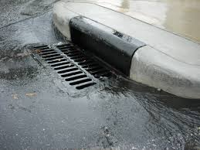
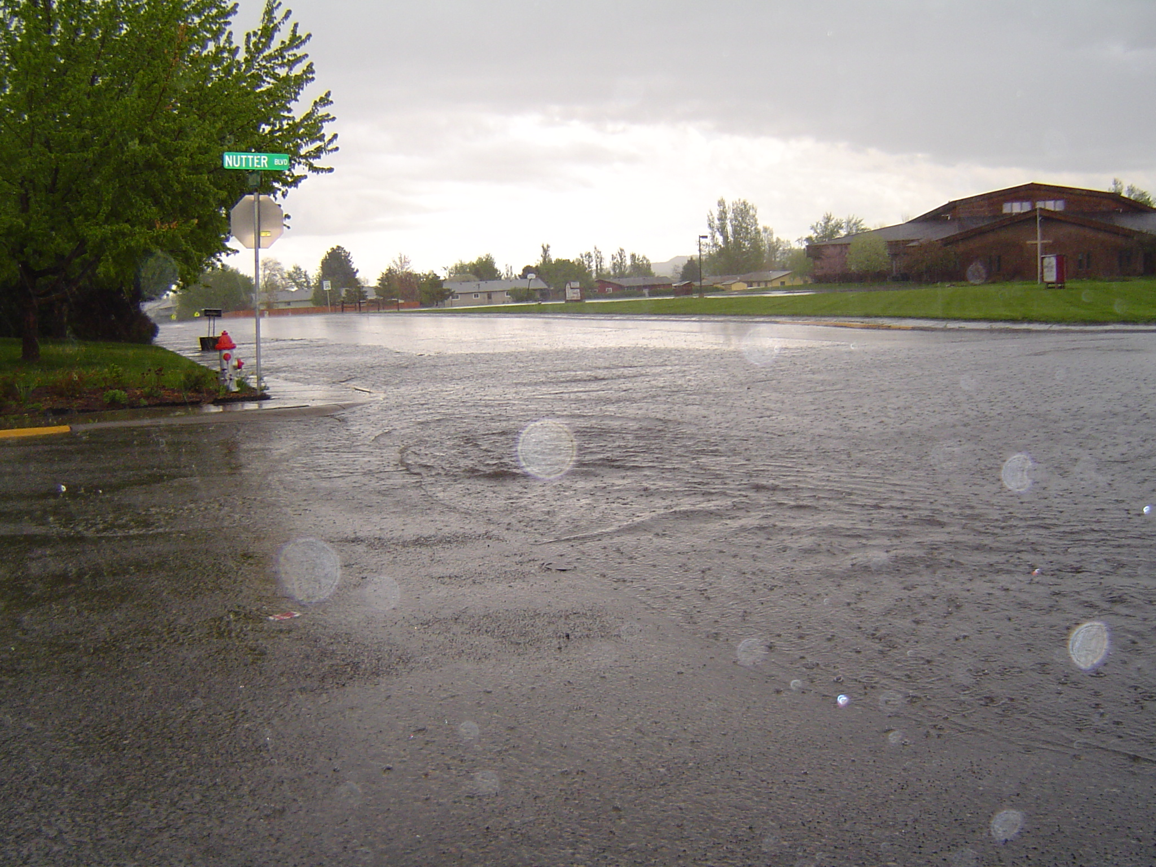
Municipally Separate Storm Sewer System Program
=
MS4

Slide 4

Why are we doing this?
…..it’s all about the water!

Slide 5
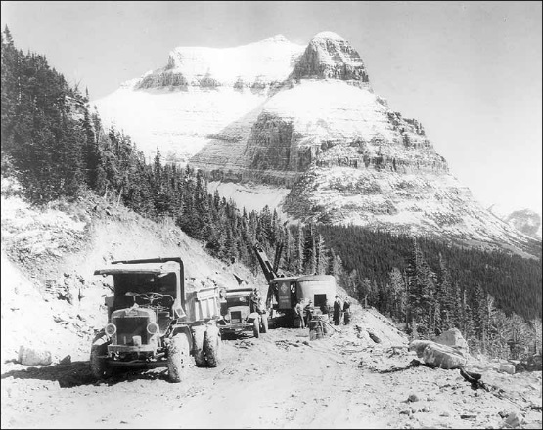
“We don’t inherit the world from the people before us…we borrow the world from the generations after us.”
Anonymous

Slide 6

Why are we doing this?
…..it is also a federal mandate
In 1972, Congress passed the Clean Water Act and focused on point source pollution discharges to surface waters. It is unlawful to discharge any pollutant from a point source to a surface water unless a permit is obtained.
A 1987 amendment to the Federal Clean Water Act (CWA) required implementation of a two-phase comprehensive national program to address storm water runoff.
Since March 10, 2003, operators of small municipal separate storm sewer systems (MS4)s in urbanized areas (UAs) applied for NPDES Phase II storm water discharge permits and began programs and practices to control polluted storm water runoff.

Slide 7
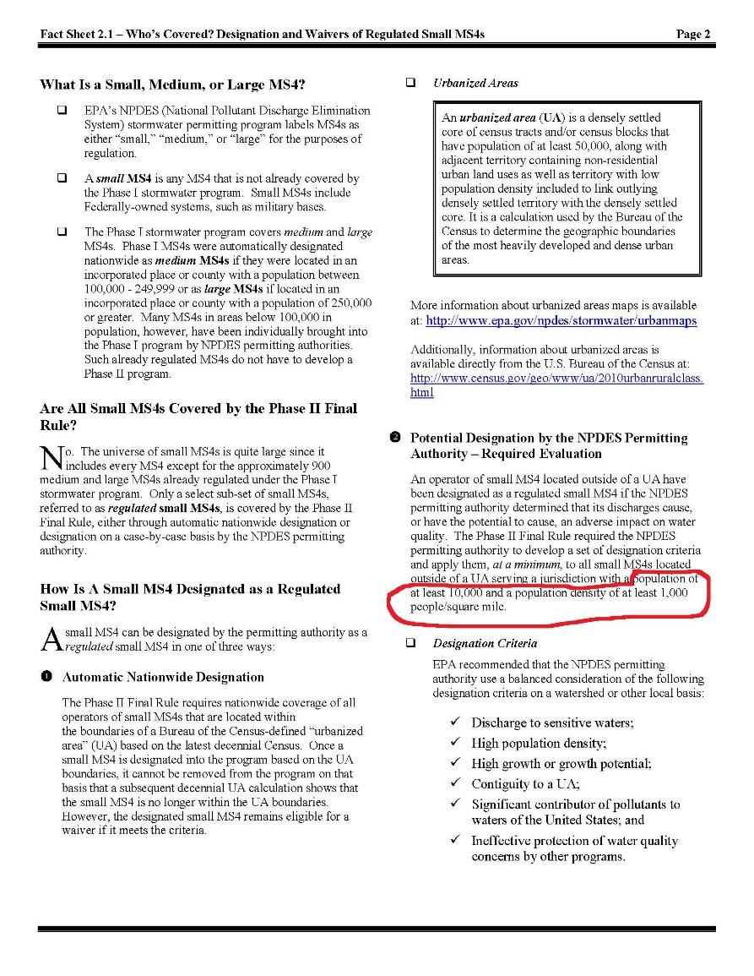
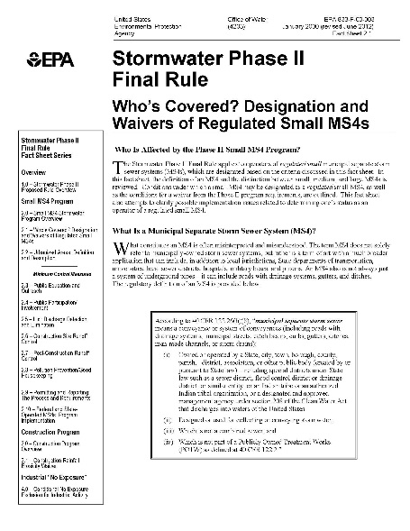
Small MS4 defined as population of at least 10,000 and a population density of at least 1,000 people/sq. mi.

Slide 8
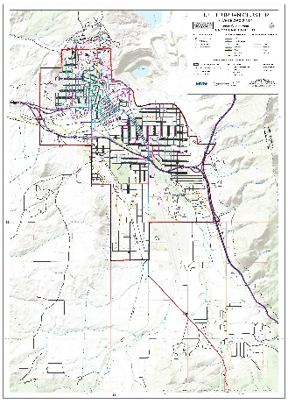
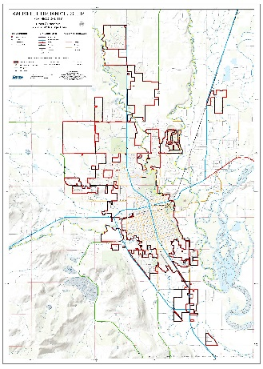
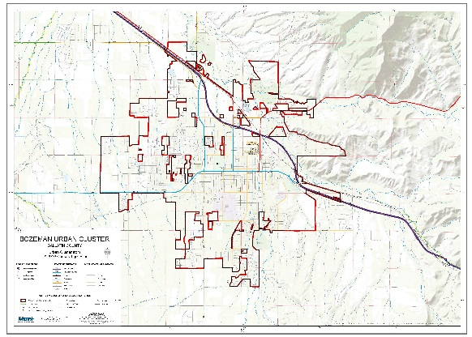
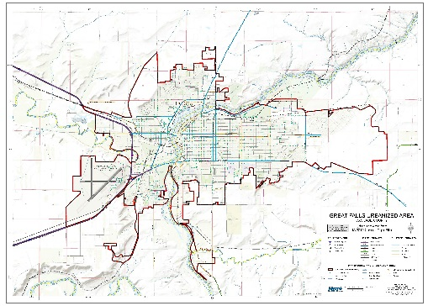
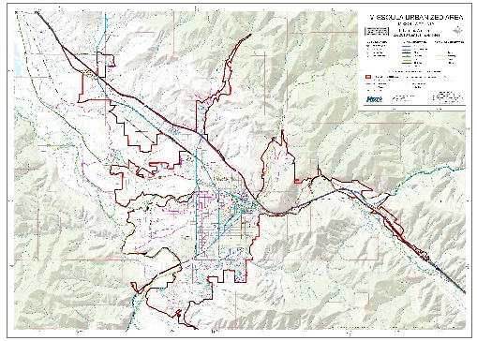
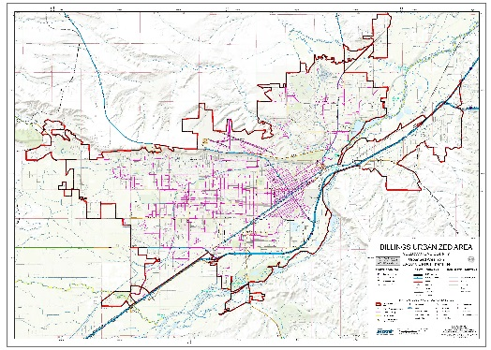
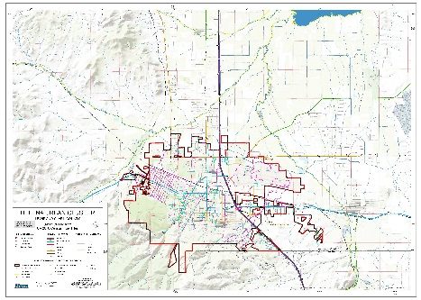
The Montana MS4 Cities are: Billings, Bozeman, Butte-Silver Bow, Great Falls, Helena, Kalispell and Missoula

Slide 9
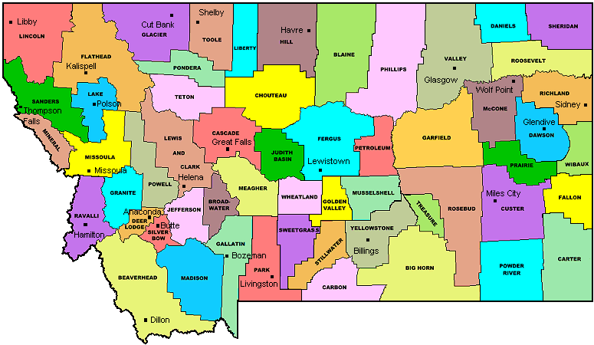
It also affects these counties…
Yellowstone
Missoula
Cascade

Slide 10
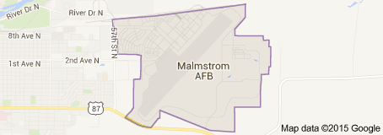
And other entities as well…
Montana Department of Transportation
Montana State University and University of Montana
Malmstrom Air Force Base

Slide 11
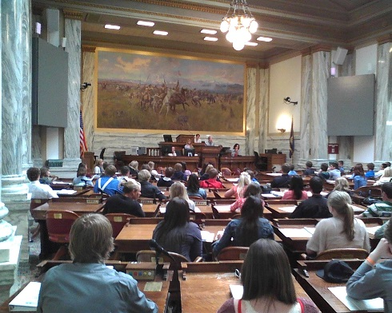
ARM 17.30.1102
(23) "Small municipal separate storm sewer system" means:
(a) small MS4s, and portions of them, that are located in the following urbanized areas in Montana as determined by the latest decennial census by the United States census bureau:
(i) the city of Billings and Yellowstone County;
(ii) the city of Missoula and Missoula County; and
(iii) the city of Great Falls and Cascade County;
(b) the following small MS4s serving a population of at least 10,000 as determined by the latest decennial census by the United States census bureau and that are located outside of an urbanized area:
(i) MS4s located in the city of Bozeman;
(ii) MS4s located in the city of Butte;
(iii) MS4s located in the city of Helena; and
(iv) MS4s located in the city of Kalispell;
(c) MS4s designated by the department pursuant to ARM 17.30.1107; and
(d) systems similar to separate storm sewer systems in municipalities, such as systems at military bases, large educational, hospital or prison complexes, and highways and other thoroughfares. The term does not include separate storm sewers in very discrete areas, such as individual buildings.

Slide 12

The future?
Cities, towns and counties close in size and density may be included on the small MS4 list…we don’t know

Slide 13

Where we are and
how we got there….

Slide 14
Montana Department of Environmental Quality (DEQ) Has the Responsibility to Issue the State-Wide Permit and Has Primacy Over the Program

Slide 15
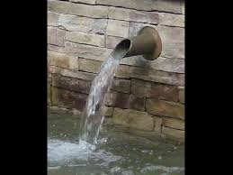
In General, Our MS4 Permits Require That We:
Implement a storm water management program
Track progress toward goals
Report on our progress

Slide 16
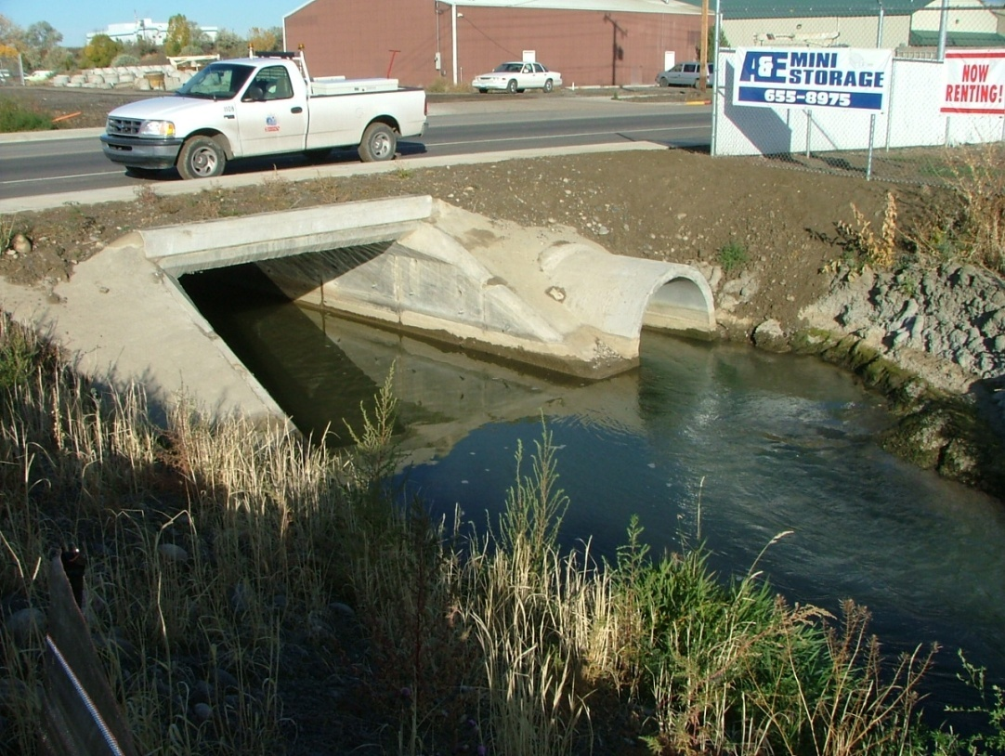
Pollutants of Concern
Sediment
Construction waste
Animal waste
Bacteria
Pesticides
Fertilizers
Solvents
Oils
Salts
Metals

Slide 17
Point of Compliance
MDEQ has said they will be logical and reasonable.
When the annual reports are submitted to MDEQ.
Groundwater…
…MDEQ has said this will not apply to this permit.

Slide 18
Audits
Each MS4 is typically audited once or twice during permit cycle
MDEQ has indicated that upcoming audits could be more rigorous than past audits.

Slide 19
Enforcement
MDEQ has indicated that the MS4s will be doing enforcements.
There will be overlap in a few areas including construction site permits and industrial permits.
MDEQ has said they will help with enforcement in difficult and sensitive situations.

Slide 20
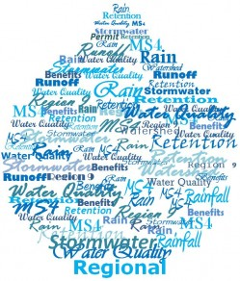
Why do we need a new permit?
The permit has a 5-year cycle and expired on December 31, 2014 (permit extended for two-years)
Federal EPA requirements…Montana needs to be in step with those requirements

Slide 21
The Preliminary Draft
Prior to the permit expiring on December 31, 2014 MDEQ had begun to draft a new permit for the next five year permit cycle.
MDEQ presented this preliminary draft to the MS4s for comment.
The MS4 Cities and Counties expressed concern with new requirements in the draft.
      The Montana MS4 Cities requested that MDEQ reissue the permit that was set to expire on December 31, 2014 for an additional two years while the Cities and MDEQ formed a working group to work together to formulate a new draft permit.

Slide 22
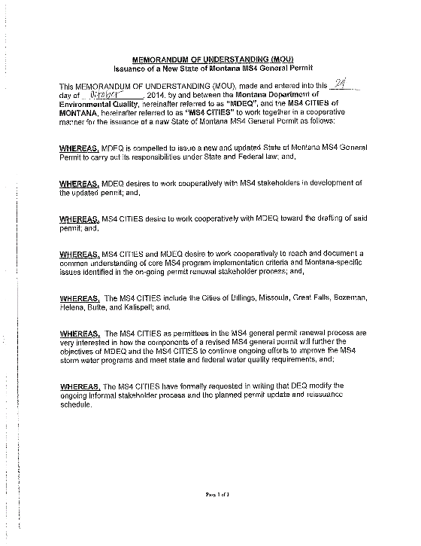
They Agreed
After consulting with the EPA, MDEQ granted that request to the MS4 Cities

Slide 23


The Logistics
The working group scheduled to complete our work by October 2016 (work in progress).
MDEQ will finalize a draft based on the working group discussions.
MDEQ will advertise the document for public comment.
MDEQ will work with EPA to review public comments and issue a new 5-year permit by January 1, 2017.
The working group will remain in place.

Slide 24

Very Important…
The work that is being done by the working group in no way circumvents the required approval process including the advertising of the draft permit when the time comes. This work will also not interfere with allowing the public to comment or any other state and federal requirements for the finalization of this permit.

Slide 25
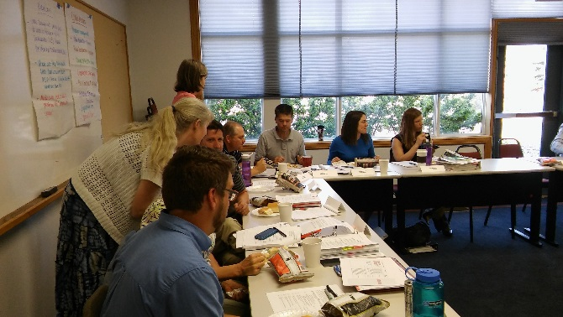
MS4 Working Group
Working group started meeting in January 2015
MDEQ, MS4 Cities, EPA
Meet the 4th Tuesday of every month
Meet at the Chamber of Commerce Building in Helena
Meeting room provided at no cost to the working group
HDR Engineering under contract for technical work

Slide 26
MS4 Working Group
The seven MS4 Cities are paying for the work HDR is doing for the new permit
MLCT is paying for the facilitator for the Working Group.
…….Thanks MLCT!!

Slide 27
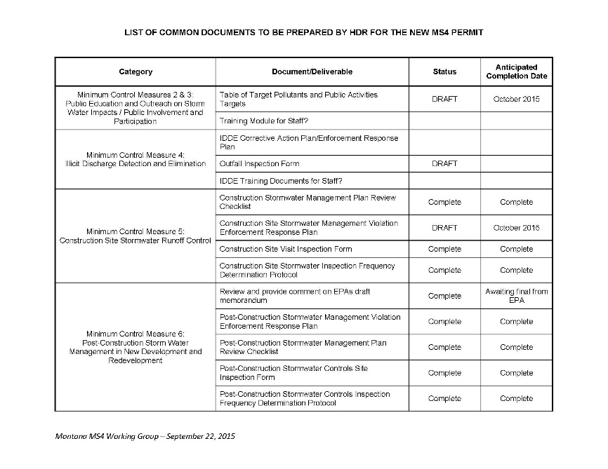
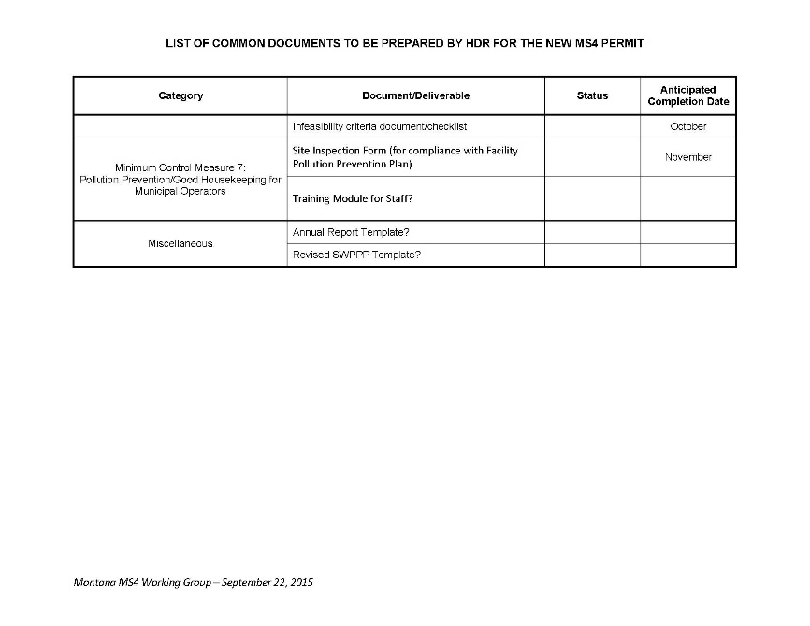
HDR working on standard documents common to all MS4 cities

Slide 28
So how does this affect me?
The working group is still working, but….

Slide 29

We Know…
There will be more documentation required
    Permit will be more specific regarding required components and objectives for the MS4s to meet and maintain permit compliance.

Slide 30

We Know…
There will be more definitive language

Slide 31
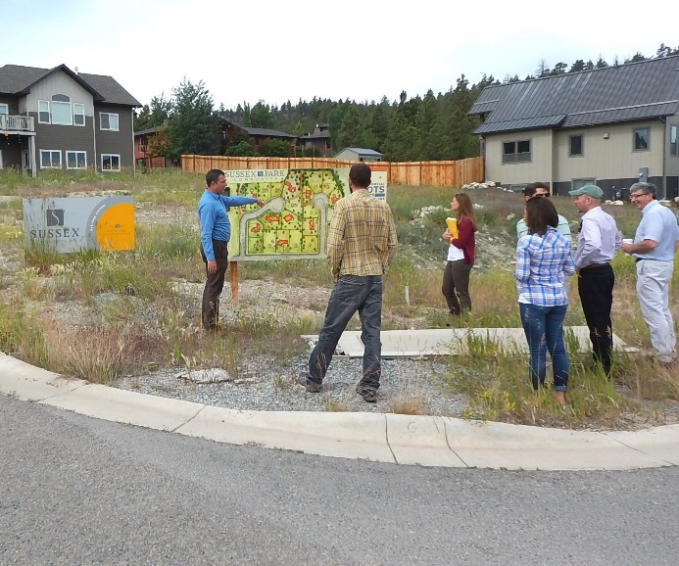
We Know…
When the permit in it’s final form it will impact the way developments are designed and affect the way that land is allocated.

Slide 32
Minimum Control Measures
Under the National Pollutant Discharge Elimination System (NPDES) Phase II regulations, the state’s MS4s must prepare a stormwater management program containing elements that address seven technical areas.
These measures are expected to result in significant reductions of pollutants discharged into receiving waterbodies.
Measures contain measurable goals.

Slide 33
Minimum Control Measures
Existing…
Public Education and Outreach
Public Involvement and Participation
Illicit Discharge Detection and Elimination
Construction Site Storm Water Runoff Control
Post construction Storm Water Management in New Development and Redevelopment
Pollution Prevention/Good Housekeeping for Municipal Operations
Working Group….
Program Management
Public Education and Outreach
Public Involvement and Participation
Illicit Discharge Detection and Elimination
Construction Site Storm Water Management
Post construction Storm Water Management in New Development and Redevelopment
Pollution Prevention/Good Housekeeping for Permittee Operations

Slide 34
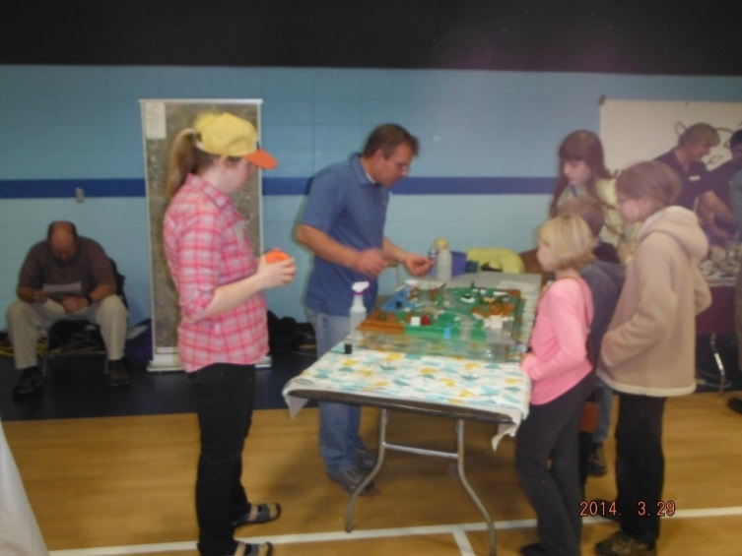
Program Management (MCM 1)
New Section…
Requirement to develop a storm water management team and establish lines of communication within that team…
Cities already have teams in place.
Teams are small and dedicated.

Slide 35
Public Education and Outreach (MCM 2)
MDEQ sums it up the best when they say…
…Identify the audience that are common sources of illicit discharges, spills
and dumping (specific pollutants of concern)
…Educate that audience
…Motivate that audience

Slide 36
Public Involvement and Participation (MCM 3)
Working Group…
Basic requirements remain the same as in the existing permit and also include:
Use MS4s storm water website to solicit input on the Storm Water Management Plan (SWMP) program implementation, and
Update information regarding storm water specific complaints and reports of illicit discharges.
Websites will require modifications to meet the new requirements.

Slide 37
Illicit Discharge Detection and Elimination (MCM 4)
What does this mean?
In simple terms illicit discharges are…
Non-storm water discharges entering a storm water system that can have adverse impacts to the storm water systems and receiving waters.

Slide 38
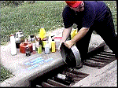
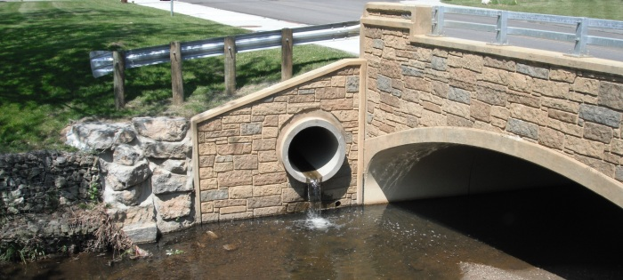
Illicit Discharge Detection and Elimination (MCM 4)
This can happen in a few ways:
Illicit discharges
Illicit connections

Slide 39

Illicit Discharge Detection and Elimination (MCM 4)
They are bad actors and we want to get rid of them!

Slide 40
Illicit Discharge Detection and Elimination (MCM 4)
Existing…
Identify the plan to detect and address illicit discharges to the system, including discharges from illegal dumping and spills.
Includes development of a storm sewer system map showing the location of all outfalls
Working Group…
Proactively inspect, during dry weather, all outfalls deemed high priority for illicit discharges.
High priority outfalls - drain industrial areas, previous detection of illicit discharges, age of the system, proximity to a water body, etc.

Slide 41
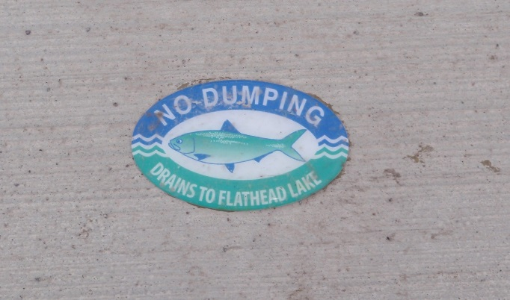
Illicit Discharge Detection and Elimination (MCM 4)
Working Group…
Develop and implement an Enforcement Response Plan (ERP) for illicit discharges.
(sets levels of appropriate enforcement actions)
Develop illicit discharge investigation and corrective action plan
(I.D.s illicit discharges)
Select the appropriate corrective action, i.e. enforcement action, abatement, etc.
(I.D.s level of enforcement from ERP)

Slide 42

Construction Site Storm Water Management (MCM 5)
This applies to…
Construction Site Storm Water Management (MCM 5) applies to sites 1 acre and greater…

Slide 43
Construction Site Storm Water Management (MCM 5)
Existing…
Requirements for construction site operators to implement appropriate erosion and sediment control BMPs;
Working Group …
Set of minimum erosion and sediment control and pollution prevention BMPs that must be included on all qualifying construction projects (using existing guidelines such as the MDEQ Construction Field Guide)
Plan review checklist to determine compliance with state and local requirements
Inspect to insure storm water controls are installed, operated and maintained

Slide 44
Construction Site Storm Water Management (MCM 5)
Existing…
Set procedures for the MS4 to perform site inspection and enforcement, in part based upon the site plan for erosion, sediment, and waste control BMPs;
Identify procedures for site inspection and enforcement of control measures.
Working Group …
Requirement to develop an (Enforcement Response Plan) ERP for construction permit violations (ensure compliance with storm water protection requirements)
ERP will describe how violator will eliminate and abate illegal construction discharges .
Cities want to work with MDEQ to have better coordination with Storm Water Pollution Prevention Plans (SWPPs) and inspections.

Slide 45
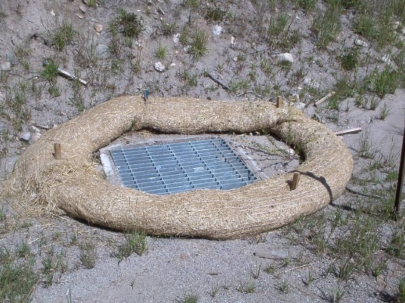
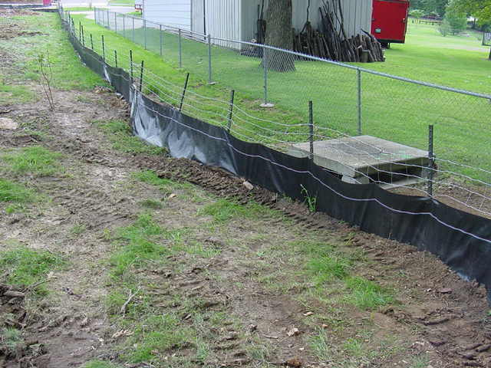
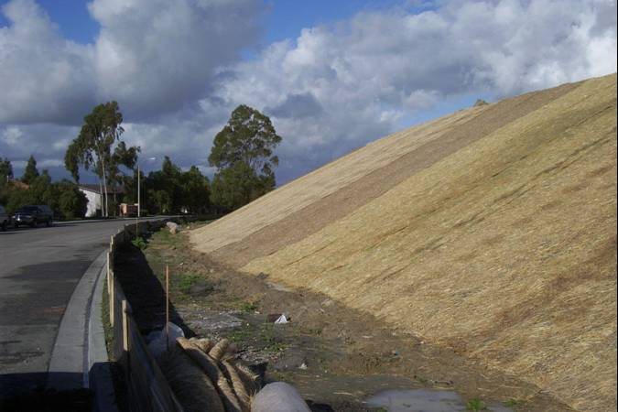
BMPs?

Slide 46
Post-Construction Storm Water Management in New Development and Redevelopment (MCM 6)
Applies to…
Post-Construction Storm Water Management in New Development and Redevelopment (MCM 6) applies to sites 1 acre and greater…

Slide 47
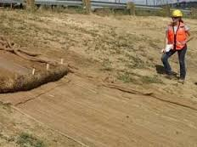
Post-Construction Storm Water Management in New Development and Redevelopment (MCM 6)
Existing…
Ensure adequate long-term operation and maintenance of BMPs;
Working Group …
Develop an inventory of all new and existing post-construction BMPs
Develop an ERP to ensure compliance.
Conduct inspections

Slide 48
Post-Construction Storm Water Management in New Development and Redevelopment (MCM 6)
Existing…
Implementation of low impact development practices that infiltrate, evapotranspire, or capture for reuse the runoff generated from the first 0.5 inches of rainfall from a 24-hour storm preceded by 48 hours of no measurable precipitation.

Slide 49
Post-Construction Storm Water Management in New Development and Redevelopment (MCM 6)
Working Group Language – Still in discussion
For projects that cannot meet 100% of the runoff reduction requirement, the remainder of the runoff from the first 0.5 inches of rainfall will need to meet certain requirements regarding total suspended solids (TSS);
Provisions for Treating offsite within the same sub-watershed using post-construction stormwater control(s) to achieve median effluent concentrations for TSS.

Slide 50
Post-Construction Storm Water Management in New Development and Redevelopment (MCM 6)
In other words….
The MS4s will need to insure that water that is released meets certain requirements

Slide 51
Post-Construction Storm Water Management in New Development and Redevelopment (MCM 6)
Working Group Language…
Evaluate barriers to implement Low Impact Development (LID)
Discuss opportunities for change

Slide 52
Post-Construction Storm Water Management in New Development and Redevelopment (MCM 6)
LID is an approach to land development (or re-development) that works with nature to manage storm water as close to its source as possible.
LID employs principles such as preserving and recreating natural landscape features,
Such as bioretention facilities, rain gardens, vegetated rooftops, rain barrels, and permeable pavements.

Slide 53
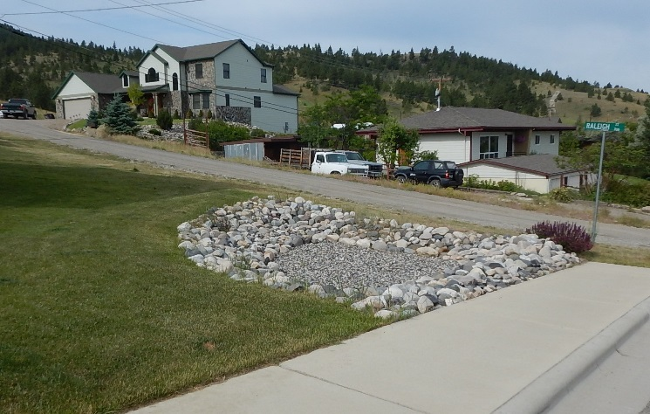
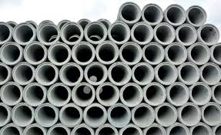
Post-Construction Storm Water Management in New Development and Redevelopment (MCM 6)
More of this….
………..and less of this
LIDs

Slide 54


Post-Construction Storm Water Management in New Development and Redevelopment (MCM 6)
The “Down” side…
…The requirements do take up developable land and increases costs
The “Up” Side…
…Improved water quality

Slide 55
Pollution Prevention/Good Housekeeping for Permittee Operations (MCM 7)
Existing…
Identify the operation and maintenance program to prevent or reduce pollutant runoff from municipal operations.
  Controls for reducing or eliminating the discharge of pollutants from streets, roads, highways , municipal parking lots, maintenance and storage yards, waste handling and disposal areas, vehicle fleet or maintenance shops with outdoor storage areas, salt/sand storage locations, and snow disposal areas operated by the permittee.
  Procedures for the proper disposal of waste removed from the permitted Small MS4 through the permittee's municipal operations, including dredge spoil, accumulated sediments, floatables, catch basin cleaning, and other debris.

Slide 56
Pollution Prevention/Good Housekeeping for Permittee Operations (MCM 7)
This is a BIG deal because:
It goes beyond Public Works Departments…
The MS4 is responsible for other departments actions!

Slide 57

Pollution Prevention/Good Housekeeping for Permittee Operations (MCM 7)
Working Group …
We are currently discussing this MCM in our group…too early to know

Slide 58
Monitoring – yet to be discussed at the working group
Existing…
The current permit doesn’t specify total maximum daily load (TMDL) specific monitoring requirements.
Working Group …
The group has not discussed this yet, but…
There will be more monitoring required relating to BMP effectiveness, outfall monitoring, receiving water monitoring for storm water discharges to impaired waters

Slide 59
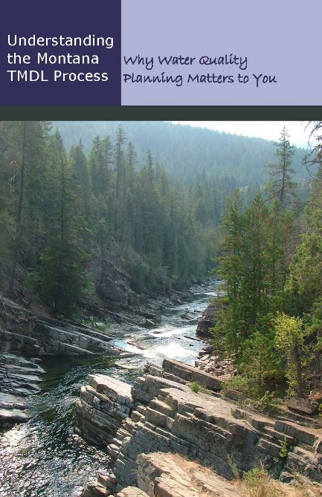
TMDL
Some Montana waters do not meet state water quality standards.
Total Maximum Daily Loads (TMDLs) are designed to help define solutions.
The Montana Water Quality Act requires DEQ to develop TMDLs for streams and lakes that do not meet, or are not expected to meet Montana Water Quality Standards
A TMDL is the maximum amount of a pollutant a water body can receive and still meet water quality standards.

Slide 60
TMDL
MDEQ is still reviewing/revising the language
But, we expect their position to remain that this is a BMP driven program and compliance with numerical limits will not be part of this permit.
MDEQ has said that they will start to be more strict with enforcement.

Slide 61
TMDL
In general MDEQ says:
if the MS4 is complying with their MS4 permit
then
the MS4 is complying with the TMDL

Slide 62
Not discussed by working group yet, but we know there will be more training required…
Municipal employees
  storm water staff involved in field activities with a potential for storm water pollution discharge.
  all inspectors and plan reviewers
  staff who work at high priority municipal facilities
The general public,
developers, builders and contractors

Slide 63
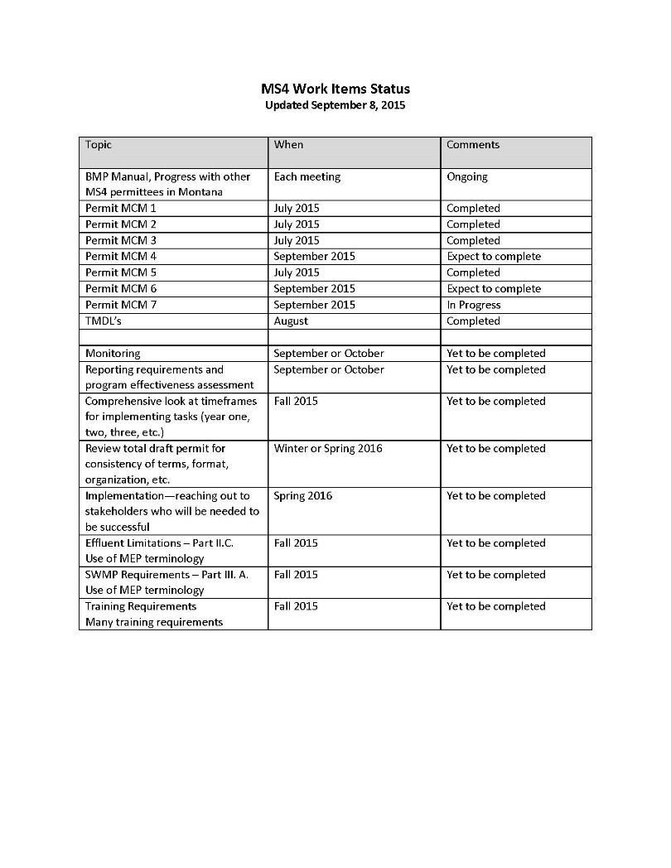
Current status of the working group

Slide 64
If you have been doing the math in your head up to now you have figured out….
+ ERPs
+ more monitoring
+ more sampling
+ more inspections
+ more training
+ more education
+ stricter MCM language
+ inventories
+ TSS for discharges for MCM 6
+ misc items
------------------------------------------

Slide 65




It adds up
For MS4s it is:
More & more &
For Developers it is:
More and less land for development

Slide 66

Questions ?

