Slide 1
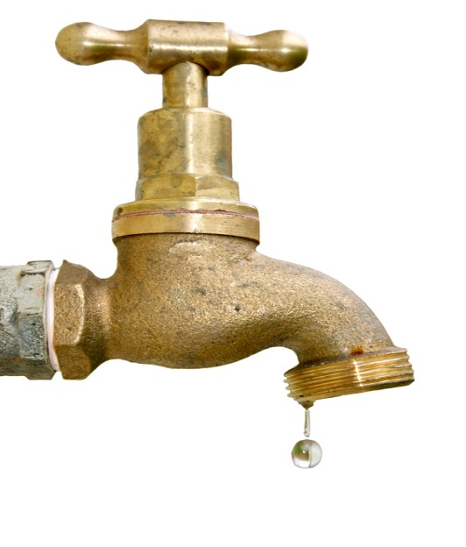
WATER RIGHTS, 101
or
What do you mean,
I’m out of Water?

Slide 2
Montana Water Use Act effective July 1, 1973
All water rights existing prior to July 1, 1973, are to be finalized through a statewide adjudication process in state courts. These rights are protected by the 1972 Montana Constitution and are referred to as “Existing Rights”.
Water uses after June 30, 1973 are administered by the DNRC through a permit system.

Slide 4
First Lesson of Water Rights
First in Time is First In Right
Date of priority is a key element
Municipalities do not get special consideration
The legislature has provided ONE exception

Slide 6
85-2-102. Definitions. Unless the context requires otherwise, in this chapter, the following definitions apply:
(1) "Appropriate" means:
(a) to divert, impound, or withdraw, including by stock for stock water, a quantity of water for a beneficial use;
(4) "Beneficial use", unless otherwise provided, means:
(a) a use of water for the benefit of the appropriator, other persons, or the public, including but not limited to agricultural, stock water, domestic, fish and wildlife, industrial, irrigation, mining, municipal, power, and recreational uses;
(b) a use of water appropriated by the department for the state water leasing program under 85-2-141 and of water leased under a valid lease issued by the department under 85-2-141;
(

Slide 7
(b) a use of water appropriated by the department for the state water leasing program under 85-2-141 and of water leased under a valid lease issued by the department under 85-2-141;
(c) a use of water by the department of fish, wildlife, and parks through a change in an appropriation right for instream flow to protect, maintain, or enhance streamflows to benefit the fishery resource authorized under 85-2-436;
(d) a use of water through a temporary change in appropriation right or lease to enhance instream flow to benefit the fishery resource in accordance with 85-2-408;
(e) a use of water for aquifer recharge or mitigation; or
(f) a use of water for an aquifer storage and recovery project as provided in 85-2-368.

Slide 8
6) "Change in appropriation right" means a change in the place of diversion, the place of use, the purpose of use, or the place of storage.
(8) "Correct and complete" means that the information required to be submitted conforms to the standard of substantial credible information and that all of the necessary parts of the form requiring the information have been filled in with the required information for the department to begin evaluating the information.
(12) "Existing right" or "existing water right" means a right to the use of water that would be protected under the law as it existed prior to July 1, 1973. The term includes federal non-Indian and Indian reserved water rights created under federal law and water rights created under state law.

Slide 9
(16) "Municipality" means an incorporated city or town organized and incorporated under Title 7, Chapter 2.
(18) "Permit" means the permit to appropriate issued by the department under 85-2-301 through 85-2-303 and 85-2-306 through 85-2-314.
(22) "State water reservation" means a water right created under state law after July 1, 1973, that reserves water for existing or future beneficial uses or that maintains a minimum flow, level, or quality of water throughout the year or at periods or for defined lengths of time.

Slide 11
Table of municipal rights data from DNRC Water Rights Query

Slide 12
A.R.M 36.12.1901 FILING A CHANGE APPLICATION
(1) An applicant who desires to change the point of diversion, place of use, purpose of use, or place of storage of a water right must file an application to change a water right (Form No. 606) and any applicable addendums.
(2) An application for a temporary change must meet the same rule requirements as those for
a permanent change application.
(3) In addition to the change application rules, an applicant proposing to temporarily change
to instream flow must submit the information required under 85-2-407 and 85-2-408, or 85-2-
436, MCA.
(4) A change application must contain sufficient factual documentation to constitute probable
believable facts sufficient to support a reasonable legal theory upon which the department
should proceed with the application.
(5) The department must consider historical use in determining whether changing the water
right would constitute an enlargement in historic use of the original water right.
(6) Only an owner of record, as shown in the department's water right records, can apply to
change a water right, except if a change application is for a water right lease pursuant to 85-2-
436, MCA, the change applicant must be the state of Montana, Department of Fish, Wildlife, and
Parks.

Slide 13
36.12.1901 FILING A CHANGE APPLICATION (continued)
(7) Multiple water rights may be changed on one application if upon completion of a project,the diversion, place of use, purpose, and storage information will be exactly the same for each water right.
(8) The legal descriptions for the point of diversion and place of use must be identified as required in ARM 36.12.110.
9) Flow rate (in gpm or cfs), volume (in acre-feet), or reservoir capacity (in acre-feet) will be rounded to the nearest tenth.
(10) The application must contain a narrative explaining the specific details of the requested water right change and why it is being requested.
(11) The proposed diverted flow rate and diverted volume of water must be identified for each changed right.
(12) The time needed to complete and put the changed project into operation must be identified. Information must be included in the application materials that justify the requested time. The justification must include information that would lead a person not familiar with the project to conclude the period requested is reasonable and needed to complete the change and put the changed water right to use.

Slide 14
DNRC personnel are very helpful, but the Claimant must substantiate historic use and records showing that the change will not effect other water users.

Slide 15
Town of Manhattan v. DNRC 2012 MT 81
Although historic use information required by DNRC must be no more than necessary to meet the statutory analysis required by 85-2-402 MCA, the change application must be “correct and complete” including requisite information on the town’s historic use of water prior to July 1, 1973.
The DNRC makes the call on what is
“correct and complete!”

Slide 16
The DREADED Abandonment Issue

Slide 17
Seminole Case on Abandonment
79 Ranch, Inc. v. Pitsch (1983) 204 Mont. 426
Two elements are necessary for the abandonment of a water right:
1. Non-use of the water for a significant period, AND
2. The intent to abandon the water right.

Slide 18
City of Deer Lodge Water Rights
Water Master determined that the City had abandoned two of its pre-1973 water right claims by failing to use the water for over 23 years.
City was unable to rebut the presumption of abandonment, where the only evidence presented was that the two water rights had been carried as assets on the city books during the 23 years prior to July 1, 1973.

Slide 19
Helena’s Historic Rights On Ten Mile Creek Declared “Abandoned” By Water Master
Or,
It’s Time to Call in the Cavalry

Slide 20
MCA 85-2-227. Claim to constitute prima facie evidence -- relevant evidence -- abandonment --criteria for presumption of municipal nonabandonment
(3) Subject to the provisions of subsection (4), a water judge may determine all or part of an existing water right to be abandoned based on a consideration of all admissible evidence that is relevant, including, without limitation, evidence relating to acts or intent occurring in whole or in part after July 1, 1973.
(4) In a determination of abandonment made under subsection (3), the legislature finds that a water right that is claimed for municipal use by a city, town, or other public or private entity that operates a public water supply system, as defined in 75-6-102, is presumed to not be abandoned if the city, town, or other private or public entity has used any part of the water right or municipal water supply and there is admissible evidence that the city, town, or other public or private entity also has:
(a) obtained a filtration waiver under the federal Safe Drinking Water Act, 42 U.S.C. 300(f), et seq.;
(b) acquired, constructed, or regularly maintained diversion or conveyance structures for the future
municipal use of the water right;

Slide 21
MCA 85-2-227. Claim to constitute prima facie evidence -- relevant evidence -- abandonment --criteria for presumption of municipal nonabandonment (continued)
(c) conducted a formal study, prepared by a registered professional engineer or qualified consulting firm, that includes a specific assessment that using the water right for municipal supply is feasible and that the amount of the water right is reasonable for foreseeable future needs; or
(d) maintained facilities connected to the municipal water supply system to apply the water right to:
(i) an emergency municipal water supply;
(ii) a supplemental municipal water supply; or
(iii) any other use approved by the department under Title 85, chapter 2, part 4.

Slide 22
WARNING: DO NOT THROW EVERYTHING AWAY!
Significant City archival documents used by Helena:
1929 Chas. T. Main Engineering Report
1925 Report on Fire Defense System
Various City Commission Hearing Minutes related to passing bond issues for improvement to water facilities
1943 US Engineer Office Flow Diagrams
Drawings and Plans for improvements

Slide 23
Other Sources of Historic Documents:
Newspaper archives in local library
Passage of bond issues to fight typhoid fever epidemic caused by open sewers.
Classified ad for lease of 200 MI of water to local farmer.
Montana Historical Society
Aerial Photographs of Helena during time of concern

Slide 24
That’s All, Folks.

